Slide 1
Common Risk Factors in the Returns on Stocks and Bonds
Eugene F. Fama
Kenneth R. French
Journal of Financial Economics 1993
Presenter: 周立軒

Slide 2
Brief Saying…
This paper identifies Five common risk factors in the return on stocks and bonds
Two stock market factors, two bond market factors, one market factor.
The five factors seems to explain all returns in stock market and bond market
Except the Low-Grade Bonds

Slide 3
Agenda
Introduction
The Steps of the Experiment
Data & Variables
Main Result
Conclusion

Slide 4
Introduction
The market βs of Sharpe-Litner, and Breedon’s consumption βs show little relation of the Cross-Sectional average returns on U.S common stocks.
Empirical variables determined average returns are:
Size, Leverage, E/P, BE/ME [Banz(1981), Bhandari(1988), Basu(1983), and Rosenberg, Reid, and Lanstein(1985)]

Slide 5
Introduction
If the market is aggregated, there must be some common factors which can explain both the common stock market and bond market .
But for bond market, the factors used to explain common stock market may not appropriate.
So, the new variables are introduced in this paper

Slide 6
The Steps for the Experiment
Choose the Data from Database
Sort the data by “Size” and “BE/ME”
Test the bond factors on market excess return
Test the market factors on market excess return
Test the stock factors on market excess return
Test the stock factors + market factors on market excess return
Test all factors on market excess return
Test the adjusted market factors on market excess return
To be continued…

Slide 7
Data & Variables
Data
From 1963 to 1991
At least appeared on COMPUSTAT for two years
Stock price in December on t-1 year and June on t year in CRSP, and book equity in December on t-1 year on COMPUSTAT

Slide 8
Data &Variables
BE/ME
SIZE
Lowest 30%
Medium 40%
Highest 30%
 | LOW | MEDIAN | HIGH
SMALL | S/L | S/M | S/H
BIG | B/L | B/M | B/H
Divided by Median of NYSE

Slide 9
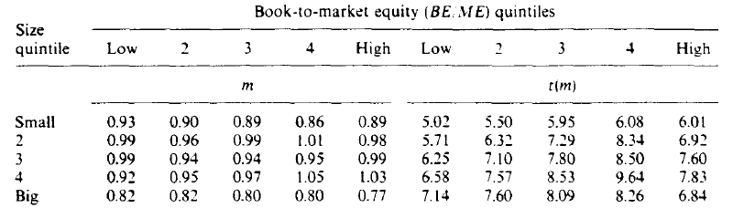
Data &Variables
In experiment, the sample will separate into 25 portfolios
First ranked by size, than by BE/ME

Slide 10
Data & Variables
Why sorting data by SIZE & BE/ME into those number of groups?
The test for these criteria are not sensitive in Fama&French(1992)
After grouping the data, we can start to define the experimental variables

Slide 11
Data & Variables
NAME | Description
RF | One-Month T-bill rate
RM | Average of all 25 Portfolios monthly return
SMB | Small-Minus-Big = AVG(S/L + S/M + S/H) – AVG(B/L + B/M +B/H), in percentage, monthly.
HML | High-Minus-Low= AVG(S/H + B/H) – AVG(S/L + B/L ), in percentage, monthly.
TERM | Long-Term government bond – RF, in percentage, monthly.
DEF | Return of market portfolio of long-term corporate bonds – Long-Term government bond, in percentage, monthly

Slide 12
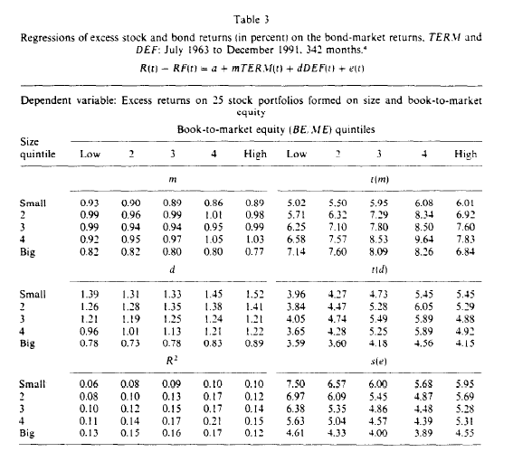
Main Result – Bond Market Factor

Slide 13
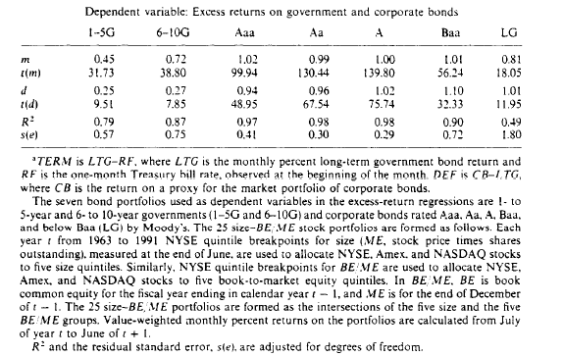
Main Result – Bond Market Test

Slide 14
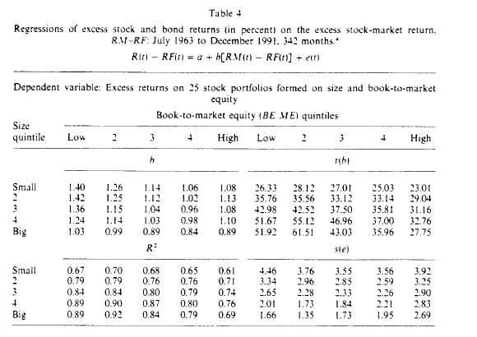
Main Result – Market Factor

Slide 15
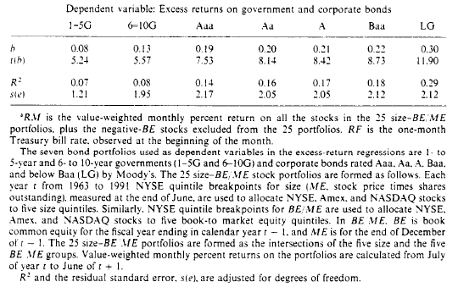
Main Result – Market Factor

Slide 16
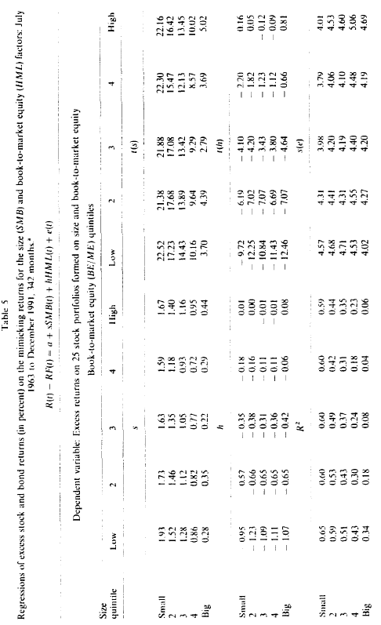
Main Result – Stock Market Factor

Slide 17
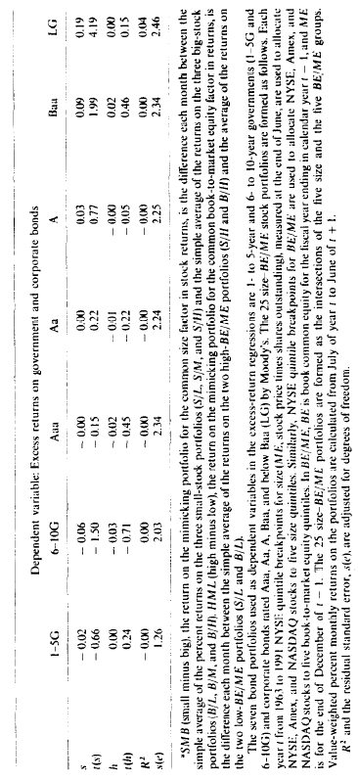
Main Result – Stock Market Factor

Slide 18
Main Result – A short break
Even though the market factor, β, seems have explained most part of the variance of stock market, the result still leave room to improve. But ,indeed, it capture more common variation for both market.
The bond market factors work well in capturing the common variation of bond market and stock market.

Slide 19
Main Result – A short break
The stock market factors, used alone, cannot explain the variation of bonds well. But they have some ability to explain the variation of stock market.
How about mix the stock market factors with market factor?

Slide 20
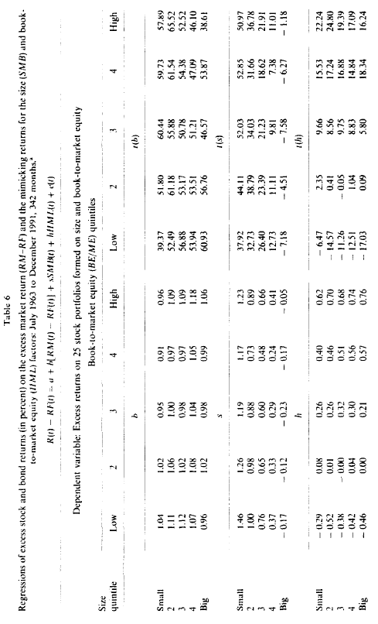
Main Result – Stock Market Factors + Market Factor

Slide 21
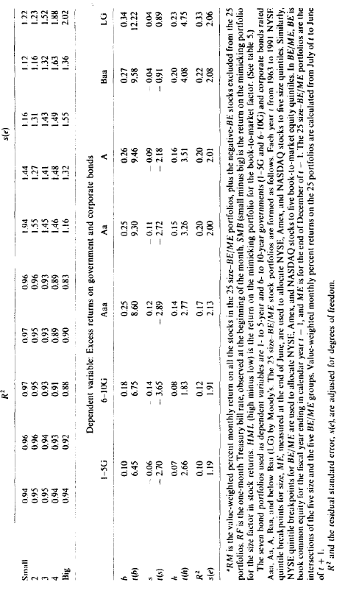
Main Result – Stock Market Factors + Market Factor

Slide 22
Main Result
Adding the stock market factors makes the market β move closed to 1.
That’s probably because the RM – Rf have some correlation with HML and SMB.
What if all five factors?

Slide 23
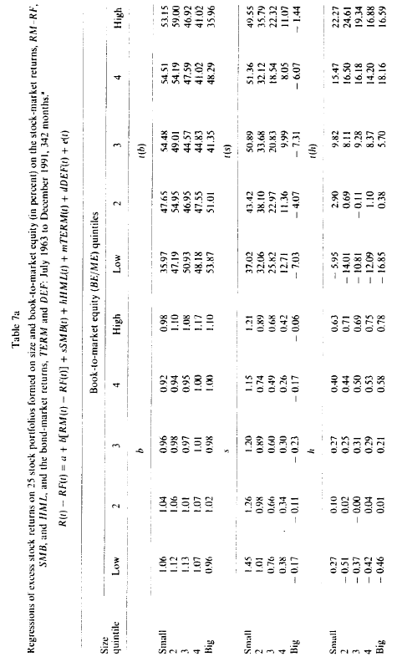
Main Result – All Factors

Slide 24
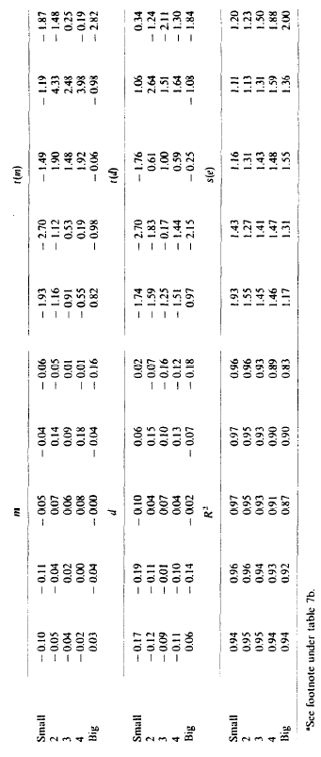
Main Result – All Factors

Slide 25
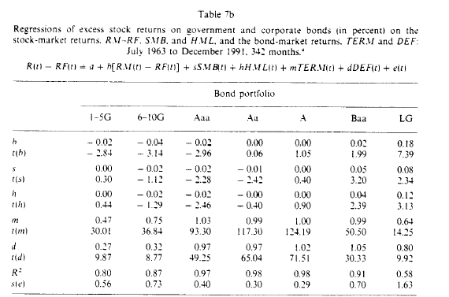
Main Result – All Factors

Slide 26
Main Result
Five factors regression seems have the contradicted result
The ability of bond market factors for capturing common variation seems lost .
Why? The market factor might be the killer.

Slide 27
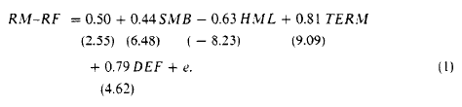
Adjusted Test
If there are multiple factors in stock returns, they are all in RM.
Break down the RM
The sum of intercept and residuals in (1) , called RMO, is the orthogonal market return, means it is uncorrelated with the other four factors
We use it to re-exam the result have shown

Slide 28
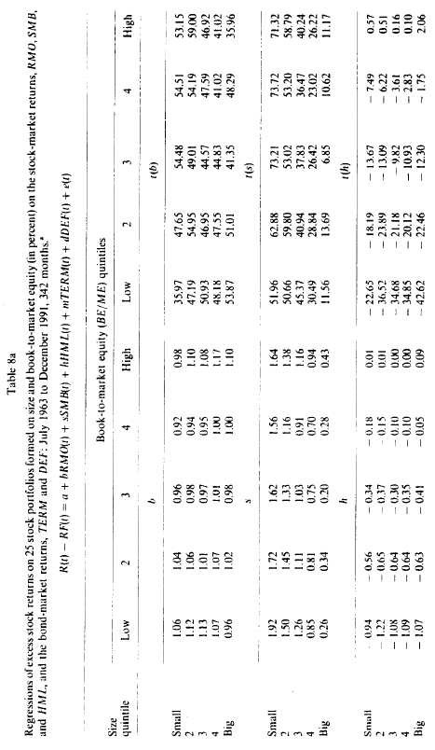
Adjusted Test

Slide 29
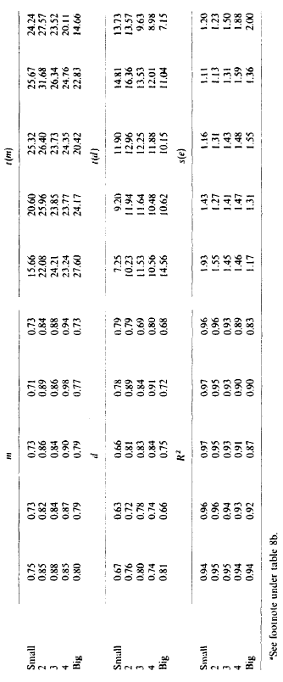
Adjusted Test

Slide 30
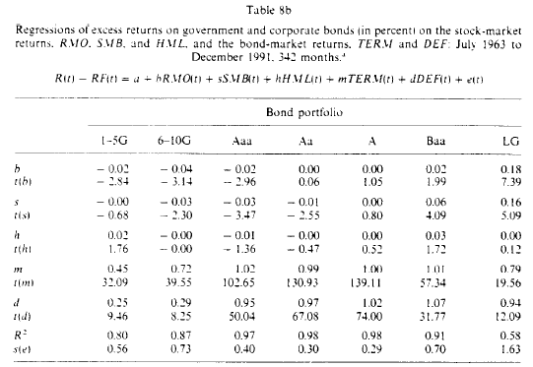
Adjusted Test

Slide 31
Test for Avg. Premium
In this part, we will test whether the five factors can explain the average premiums on bond and stock markets.
If the five factors are suffice to explain the average returns in market, the intercept should be indistinguishable from 0.

Slide 32
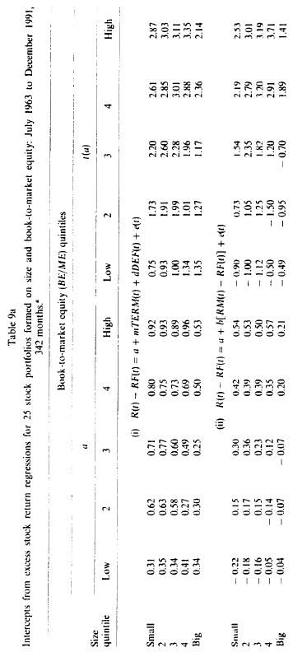
Test for Avg. Premium

Slide 33
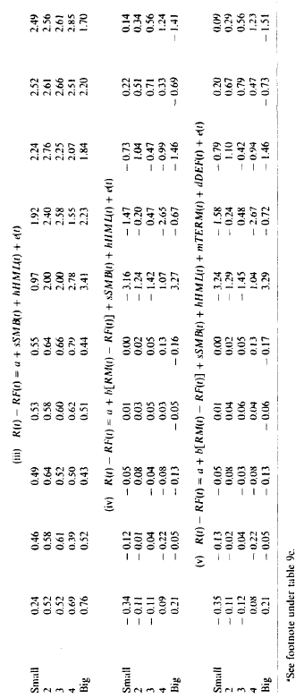
Test for Avg. Premium

Slide 34
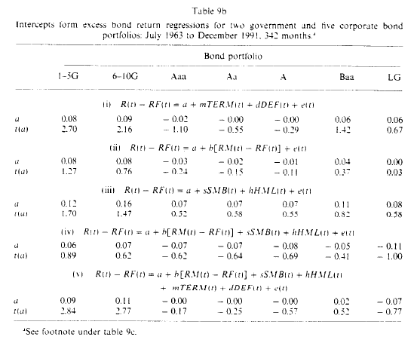
Test for Avg. Premium

Slide 35
Test for Avg. Premium
The intercept in regression on market factor shows the average premium is affected by SIZE and BE/ME
The market β cannot explain this
But, the market factor is needed to explain why average returns are higher then one-month T-bill rate
In three factor regression, the intercept is closed to 0, this means RM-Rf, HML, SMB can explain the market return well
This is a strong support for Three-Factor Model

Slide 36
Test for Avg. Premium
The TERM and DEF, have little effect on explaining the average premium, although they seem to works well on explaining stock return when used alone.
That may because the average return for TERM and DEF are small, but their high volatility can absorb the common variation well.
So, they can explain the common variation well, but cannot do it as well in average premium

Slide 37
The Bond Market Factors
Do the low premiums of TERM and DEF mean that they are irrelevant with a well-specified asset-pricing model?
Not really, the two factors are affected by business cycle, so, even if the two factors are lack to explain the average premium, they still play a role in model.

Slide 38
Conclusion
The RMO, which is uncorrelated with the other four factors, slopes are all closed to 1 on 25 portfolios, and can be viewed as the premium for being a stock.
The slope for RMO is similar to RM – Rf, so the function of explaining the cross-sectional return are left to SMB and HML
Slope for SMB (in Table 8)can explain why small stock’s returns are much volatilie

Slide 39
Conclusion
As above, the slope for HML can demonstrate the lowest BE/ME portfolio are volatile than the highest BE/ME portfolio
BE/ME is negative correlated with Profitability
The slope for HML can prove this
Five factors do a good job on explaining the whole market’s return
But for evaluating the cross-sectional average stock returns, the three-factor model will be a good alternative

Slide 40
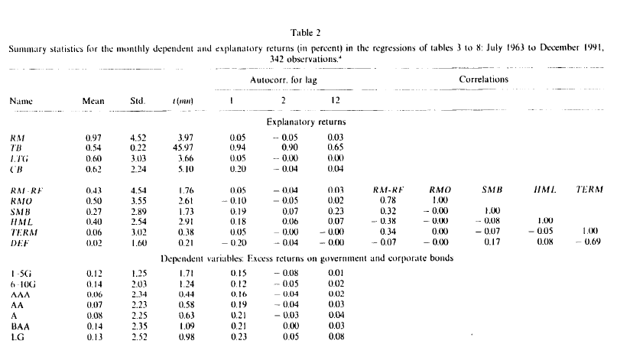
Appendix: Table2

Slide 41
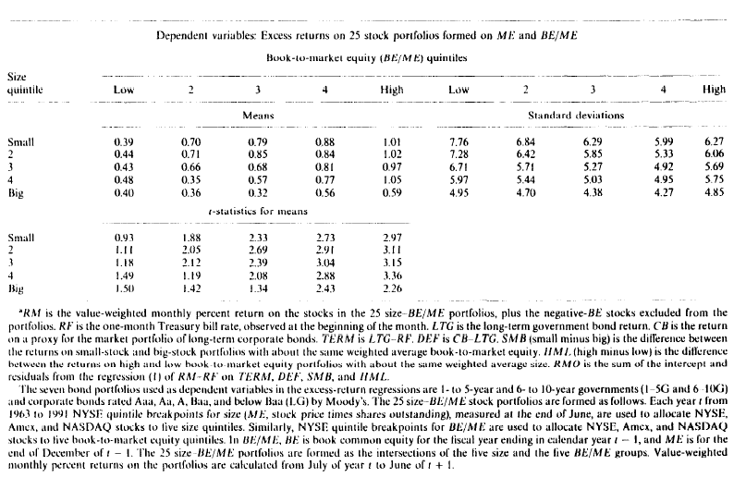
Appendix: Table 2

